Slide 1

Music Recommender System
Student : Neremzoiu Ionuț-Dragoș
Scientific Coordinator : Prof. Univ. Dr. Ing. Costin Bădică
JULY 2022

Slide 2





Why Recommender Systems?
They have increasingly become an essential part of daily online activities (e.g. Netflix, Spotify, Amazon, etc.)
By having a general or an instinctual idea of how such systems work, one can make use of it, by making it generate recommendations as relevant as possible according to one’s tastes, preferences, etc.

Slide 3
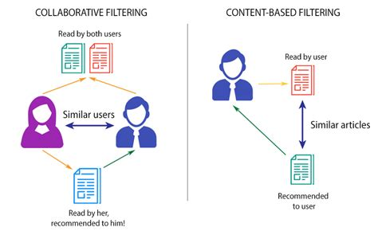
Classification of Recommender Systems
Collaborative filtering : relies on past interactions between users and items (ratings given by users on items, whether a user viewed an item or not, times a user viewed an item during a timespan,etc.) to recommend items to a user based on interests of similar users.
Content-based filtering: uses item features to suggest other items similar to what the user likes/interacts with.

Slide 4
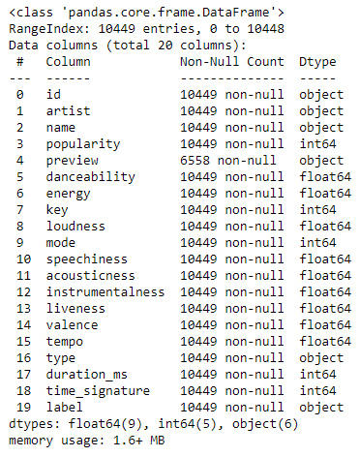
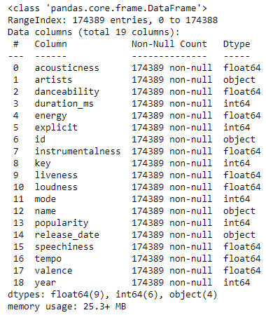
Datasets used
2 different datasets collected via Spotify Web API
Both have shared and unshared attributes
Both can only be used for content-based approaches
Type, time_signature, preview and label belong to dataset with 10449 entries
release_date and year belong to dataset with 174389 entries

Slide 5
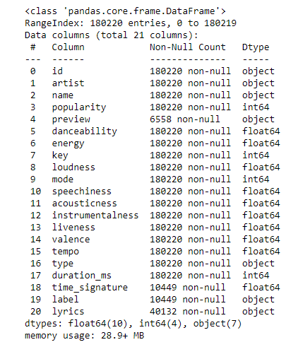
Final dataset info
After merging both datasets by taking into consideration only shared attributes data of songs and removing duplicates =>180220 songs with the same number of non-null values for shared attributes.
Lyrics were collected for 40132 via lyrics.ovh API.

Slide 6
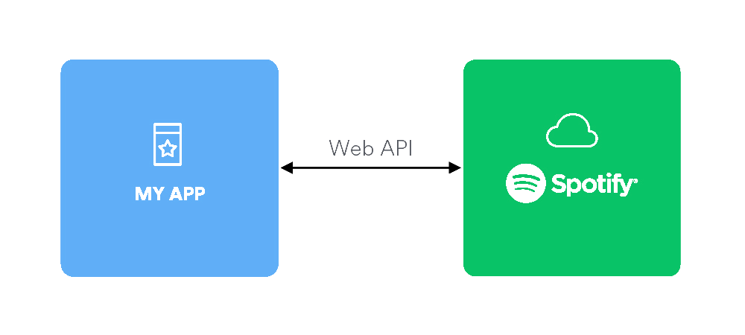
Shared features
Besides name of artist(s), song title, popularity rating (0-100) and lyrics there are the following features:
Mood : Danceability, Valence, Energy, Tempo
Properties: Loudness, Speechiness, Instrumentalness, Duration
Context : Liveness, Acousticness

Slide 7
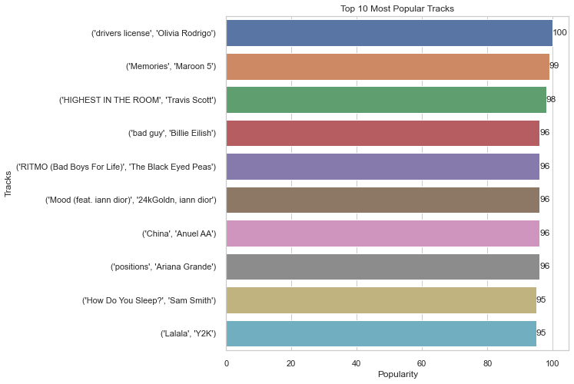
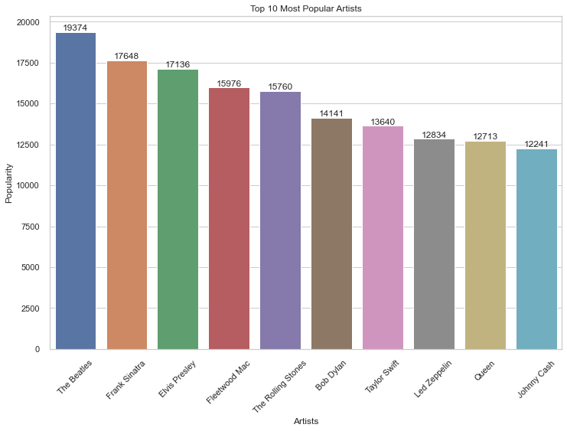
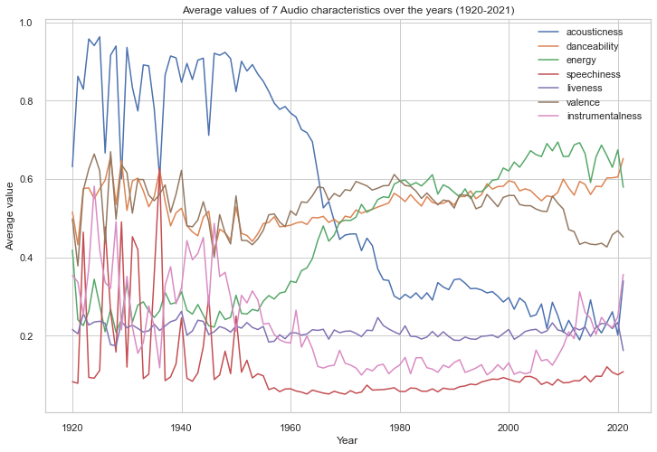
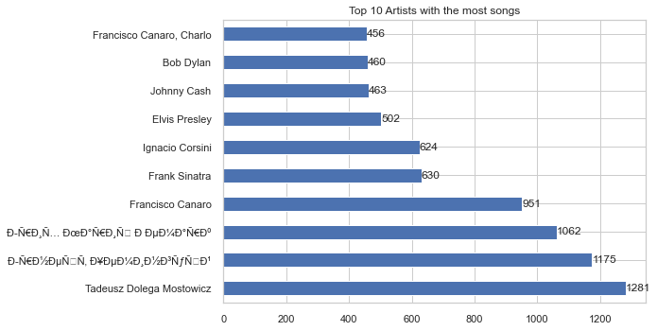
Data visualization

Slide 8
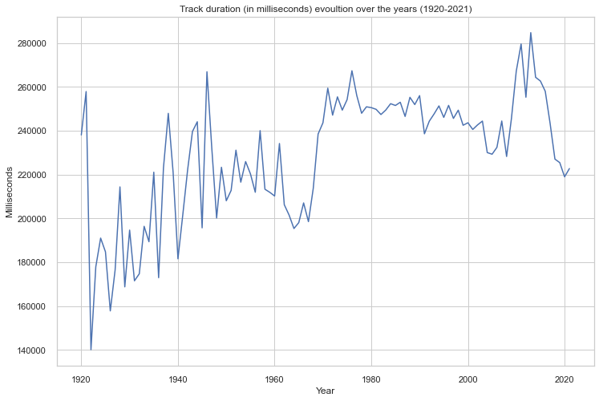
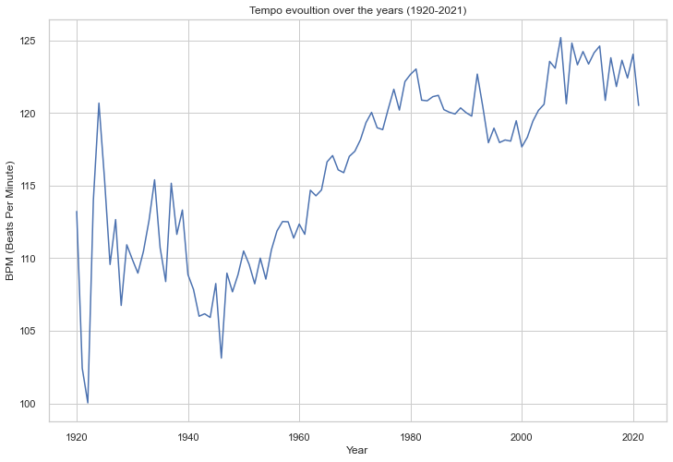
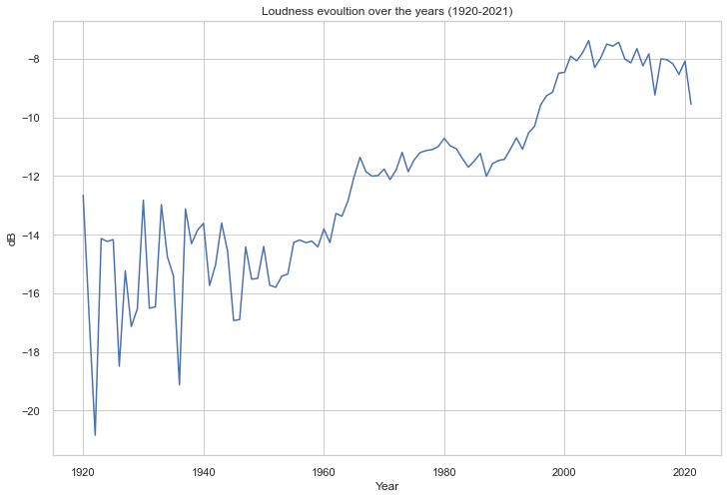
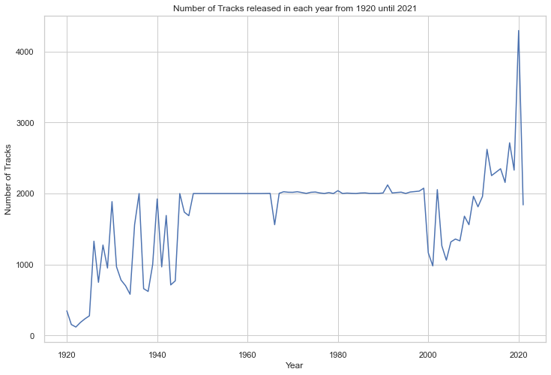
Data visualization

Slide 9
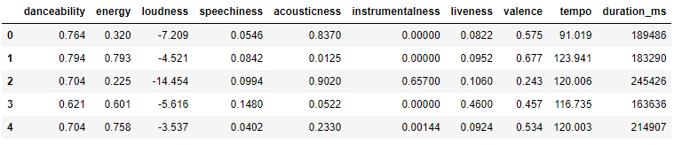
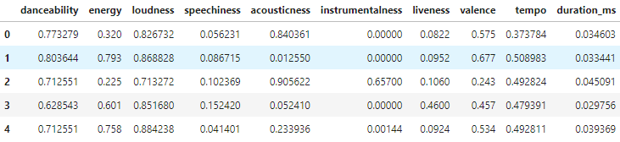
Feature Selection and Min-Max Scaling
Firstly, only the numerical common features are extracted in order to be further used in data preprocessing.
Features selected before Min-Max
Features selected after Min-Max
Min-Max Scaling
$x′=\frac{x − min(x)}{\max\left(x\right) − min(x)}$, $such that$ $x^{′}∈\left[0,1\right]$, where $x^{′}$ is any value from the selected features

Slide 10
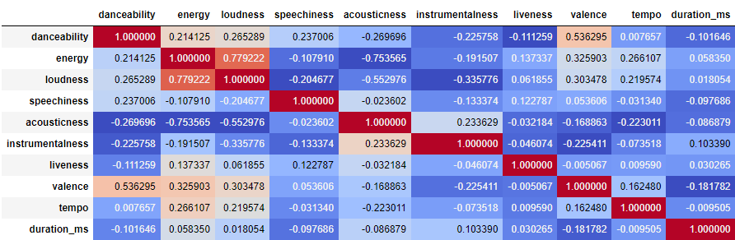
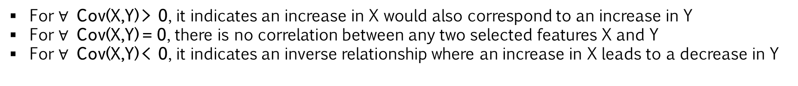
Feature Correlation
For $∀$ Cov(X,Y) > 0, it indicates an increase in X would also correspond to an increase in Y
For $∀$ Cov(X,Y) = 0, there is no correlation between any two selected features X and Y
For $∀$ Cov(X,Y) < 0, it indicates an inverse relationship where an increase in X leads to a decrease in Y

Slide 11
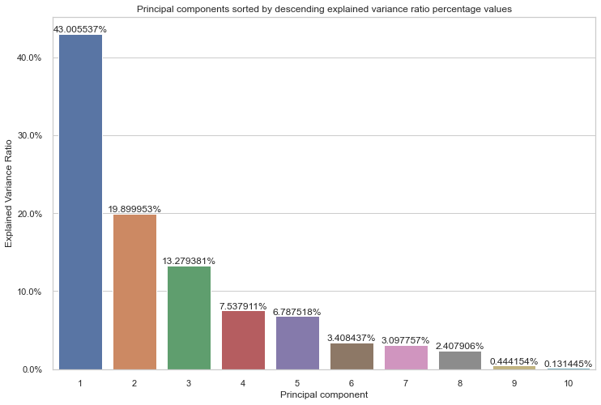
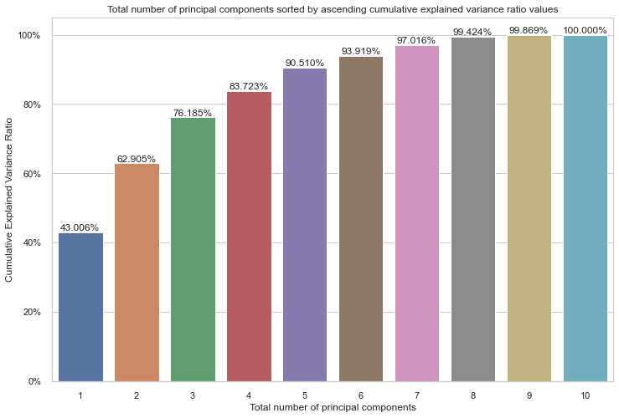
Data Reduction
Principal component by explained variance ratio
Total number of principal components by cumulative explained variance ratio

Slide 12
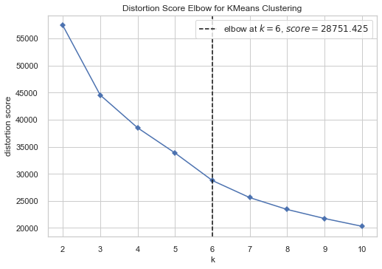
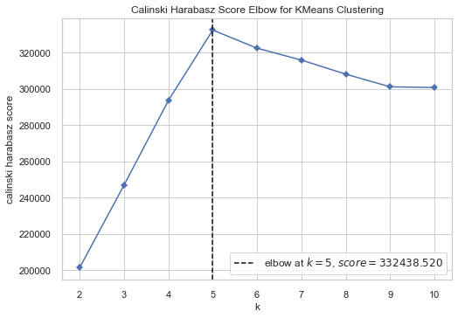
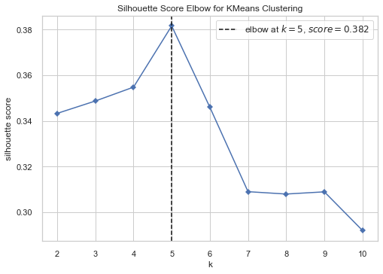
K-Means clustering. Finding optimal K for K-Means clustering.
6 principal components => 93,9%
2 principal components => 62,9%
5 principal components => 90,5%

Slide 13
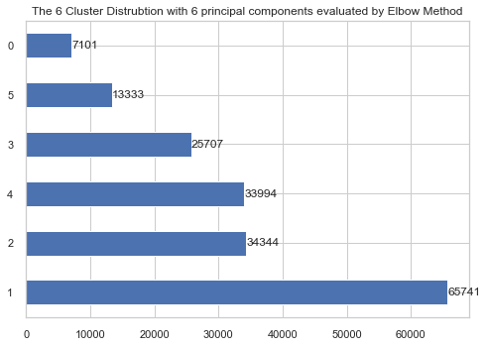
K-Means clustering. Distribution of songs on 6 clusters.

Slide 14
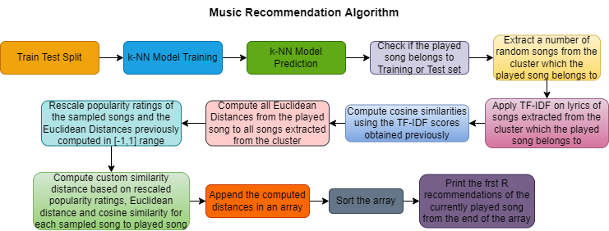
Recommendation algorithm
Input : Song index (I), number of recommendations (R) and number of random song samples (S)
Output: first R most similar songs

Slide 15

Recommendation algorithm – Formula scalings
$$MinMaxPopularity(c)=−1+\frac{(P\left(c\right)−P_{min})∗2 }{P_{max}−P_{min}}$$
$$MinMaxEuclideanDist\left(c\right)=1−\frac{(EuclideanDist\left(c,p\right)−minEuclideanDist\left(D\right))∗2 }{maxEuclieanDist\left(D\right)−minEuclideanDist\left(D\right)}$$
$$CustomDist\left(c,p\right)=\frac{MinMaxPopularity\left(c\right)+\cos\left(c,p\right)+MinMaxEuclideanDist\left(c,p\right)}{3}$$
Where c/p is either the vectorial representation in 6 principal components, index or TF-IDF scores of the current/played song.

Slide 16
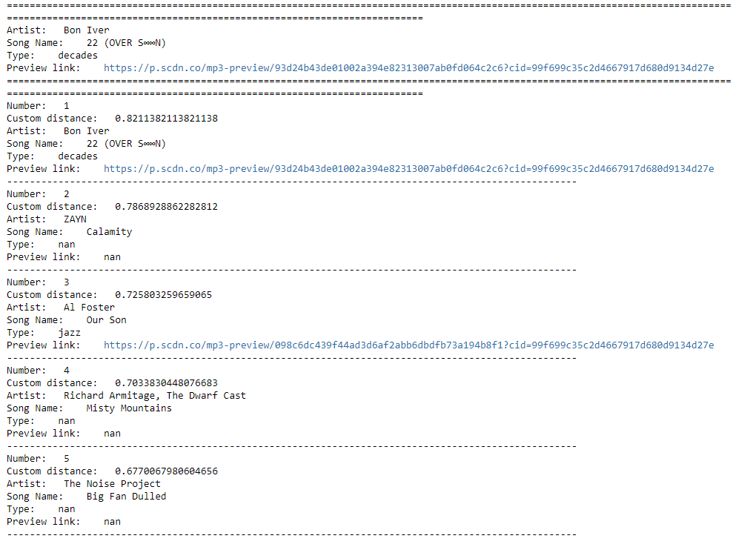
Example of recommendations for a song

Slide 17
Recommendation algorithm – similarity distances
Train Test Split
80-20 ratio => 144,176 songs for training and 36,044 for testing.
ML model is based on the training set in order to make predictions which can then be used for evaluation purposes, when comparing with actual (test) values.
k-NN
non-parametric supervised learning method used both for regression and classification.
For both cases, the input consists of the k closest training examples in a dataset.
For classification, the output is a class membership. An object is classified by plurality vote of its neighbours, with the object being assigned to the class most common among its k nearest neighbours.
TF-IDF
evaluates how relevant a word is to a song in a collection of songs.
is done by multiplying two metrics : how many times a word appears in a document (TF) and inverse document frequency of the word across the set of documents (IDF)

Slide 18
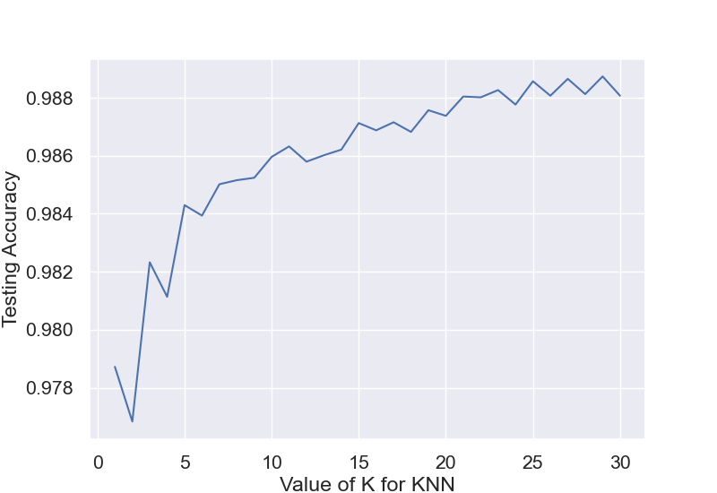
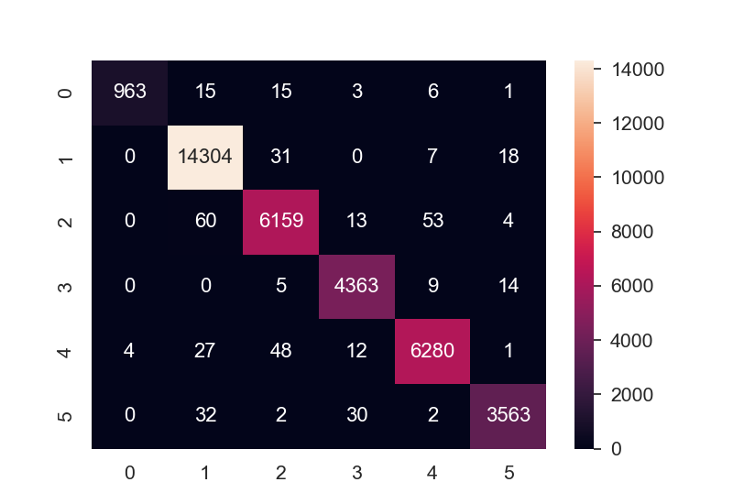
Evaluation of experimental system

Slide 19
Conclusions and limitations
Due to lack of user data, recommendations cannot be personalized and human-based evaluations metrics are not applicable.
There are few song lyrics collected.
Recommendation algorithm is slow performance-wise due to the fact every time it is run TF-IDF is computed.
There is no evaluation made for the quality of recommendation.

Slide 20
Future work
Collecting more song lyrics and cleaning them by removing impurities (presence of tags such as [VERSE 1])
Evaluations for quality of recommendations
Improving algorithm run-time performance
Collecting missing attribute data for certain entries (e.g. year, preview, etc.)

Slide 21

Thank you for your attention !

